Slide 1
Environmental Applications of Microbes
Bioremediation
Biodegradation of xenobiotic compounds
Bioremediation of heavy metals
Biomining
Waste water treatment

Slide 2
Bioremediation
The destruction or removal or reduction of the concentration of hazardous elements below toxic levels with the help of microorganisms
Involve a single microorganism or a group of microorganisms (referred as a consortium).
Bioremediation:
in situ (on site)
ex situ (away from the site,

Slide 3
Essential factors for microbial bioremediation
Factor Desired Conditions
Microbial population Suitable kinds of organisms that can biodegrade all of the contaminants
Oxygen Enough to support aerobic
Water Soil moisture should be from 50–70% of the water holding capacity of the soil
Nutrients Nitrogen, phosphorus, sulfur and other nutrients
Temperature Appropriate temperatures for microbial growth (0–40˚C)
pH Best range is from 6.5 to 7.5

Slide 4
in situ bioremediation
Biostimulation refers to the stimulating activity of the microorganisms by providing nutrients like phosphorus, nitrogen, oxygen and other electron acceptors
Bioaugmentation refers to the incorporation of microbes in the subsurface environment to overcome the deficiency of decontaminating microorganisms to degrade specific decontaminants

Slide 5
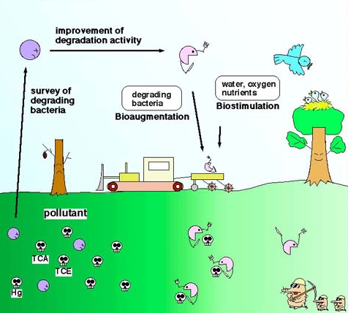
in situ bioremediation
http://www.nies.go.jp/kenko/biotech/bioehp/Topics1.html

Slide 6
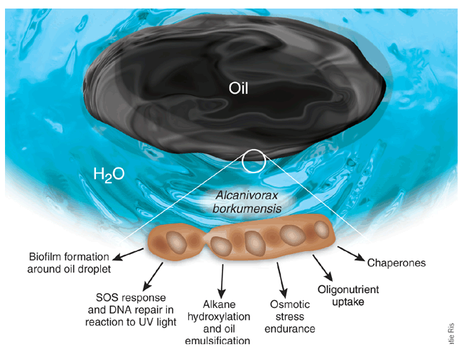
in situ bioremediation of oil spills
https://microbewiki.kenyon.edu/index.php/File:Lorenzo.gif

Slide 7
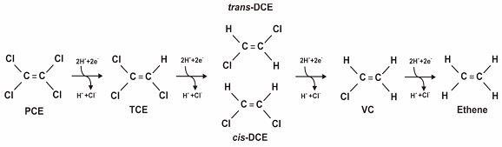
De-chlorination
Reductive dechlorination of tetrachloroethene (PCE) and trichloroeth- ene (TCE) to ethene using a microbial consortium KB-1 under anaerobic condition.
Dehalorespiring bacteria are Dehalospirillum multivorans, Dehalococcoides ethenogenes and Dehalobacter restrictus.
Biostimulation of indigenous bacteria
Bioaugmentation with KB-1
https://clu-in.org/techfocus/default.focus/sec/Bioremediation/cat/Anaerobic_Bioremediation_(Direct)/

Slide 8
Biodegradation of Xenobiotic Compounds
Xenobiotic are chemically synthesized, unnatural compounds which are foreign to biosphere.
Halogenated aliphatic and aromatic compounds
Nitro-aromatics
Phthalate esters
Polycyclic aromatic hydrocarbons

Slide 9
Bioremediation of heavy metals
Heavy metals such as lead, mercury, cadmium, chromium, copper, to name a few, are very toxic.
Toxic heavy metals released by industries poison the environment and threaten water supplies.
Microorganisms immobilize metal ions by both active and passive processes.
For example, bacteria that use sulfate as a terminal electron acceptor actively produce and excrete an ion, sulfide, that forms an insoluble complex with metal ions present in solution causing the ions to precipitate.
Biosorption (strong binding of metal ions to bacterial cells and to polymeric substances secreted by the cells) is a passive process seen with both living and dead cells.

Slide 10
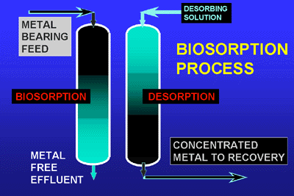
Bioremediation of heavy metals
http://biosorption.mcgill.ca/BT/BTbrief.htm

Slide 11
Bioremediation of heavy metals
http://biosorption.mcgill.ca/BT/BTbrief.htm

Slide 12
Mechanisms for heavy metal biosorption process
Hansda (2015) Research Journal of Environmental Toxicology

Slide 13
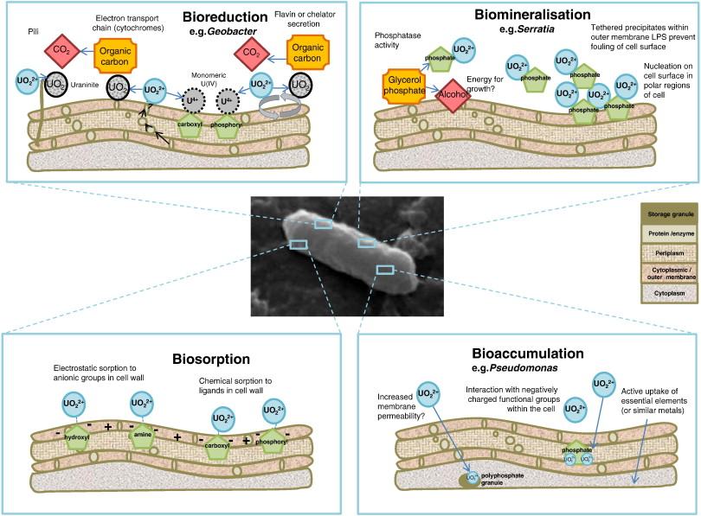
Bioremediation of Uranium
Newsome et al (2014) Chemical Geology

Slide 14
Biomining
Biomining is the use of microbes to recover minerals and metals from the earth’s crust.
Biomining comprises of two microbial processes:
Bioleaching: The conversion of an insoluble metal (generally a metal sulfide, e.g., CuS, NiS, ZnS) into a soluble form (usually the metal sulfate, e.g., CuSO₄, NiSO₄, ZnSO₄)
Bio-oxidation: bacterial oxidation of reduced sulphur species associated with the metal of interest
Bioleaching has been successfully employed for the extraction of gold, copper, iron and uranium
Acidophilic sulphur-oxidizing bacteria, particularly Thiobacillus ferrooxidans, play a major role in metal solubilization (leaching)

Slide 15
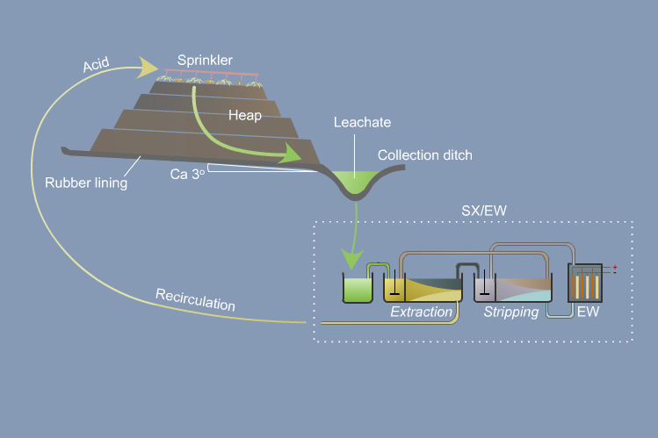
Biomining

Slide 16
Biomining of copper

Slide 17
Biomining of copper

Slide 18
Wastewater treatment
The challenge of wastewater treatment is to remove:
Compounds with a high biochemical oxygen demand
Pathogenic organisms and viruses
A multitude of human-made chemicals

Slide 19
Wastewater treatment
Options for the treatment of waste-waters include:
Biological treatments, involving aerobic and/or anaerobic processes
Chemical treatments, such as coagulation, flocculation, precipitation and electrochemical processes
Physical treatments, often in the form of screening, sedimentation or incineration.

Slide 20
Wastewater treatment
Biological wastewater treatment plant can be divided into three main stages:
Primary treatment (preliminary treatments and primary sedimentation)
Secondary treatment (aerobic and/or anaerobic biological treatment and secondary sedimentation)
Tertiary treatment, which includes processes that, where necessary, remove any remaining inorganic nutrients, especially phosphate and nitrate.

Slide 21
Waste-water treatment

Slide 22
Waste-water treatment

Slide 23
Waste-water treatment

Slide 24
Microbiological treatment
The basic microbiological phenomenon in the treatment of wastes in aqueous environments is as follows:
The degradable organic compounds in the waste water (carbohydrates, proteins, fats, etc.) are broken down by aerobic micro-organisms mainly bacteria and to some extent, fungi. The result is an effluent with a drastically reduced organic matter content.
The materials difficult to digest form a sludge which must be removed from time to time and which is also treated separately.

Slide 25
Aerobic breakdown of raw waste waters
Activated sludge
The two methods which are usually employed include the activated sludge and the trickling filter:
The activated sludge system: The activated sludge method is used for treating waste waters. Its main features are as follows:
It uses a complex population of microorganisms of bacteria and protozoa
Microorganisms has to cope with an uncontrollably diverse range of organic and inorganic compounds some of which may be toxic to the organisms.
The microorganisms occur in discreet aggregates known as flocs.
Flocs consist of bacterial cells, extracellular polymeric substances, adsorbed organic matter, and inorganic matter. Flocs are highly variable in morphology, typically 40 to 400 mm and not easy to break apart.

Slide 26
Aerobic breakdown of raw waste waters
Activated sludge

Slide 27
Aerobic breakdown of raw waste waters
Activated sludge
The flocs must have good settling properties so that separation of the biomass of microorganisms and liquid phases can occur efficiently and rapidly in the clarifier.
Some of the settled biomass is recycled to inoculate the incoming raw sewage because it contains a community of organisms adapted to the incoming sewage.
The solid undigested sludge may be further treated into economically valuable products

Slide 28
Aerobic breakdown of raw waste waters
Activated sludge

Slide 29
Aerobic breakdown of raw waste waters
Trickling filter
Trickling filter
A coating of microorganisms form (Biofilm) on the stones as the waste water trickles down the filter and these organisms break-down the waste. Fungi, algae, protozoa and bacteria form on the rocks.

Slide 30
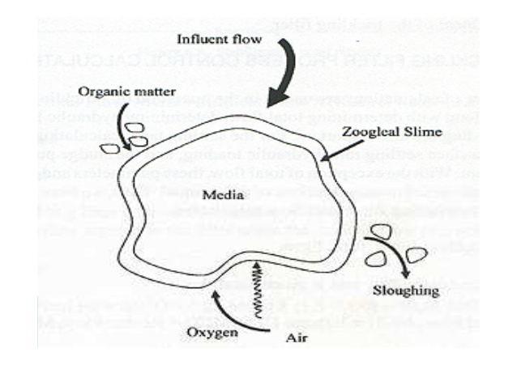
Aerobic breakdown of raw waste waters
Trickling filter
Trickling filter
A coating of microorganisms form (Biofilm) on the stones as the waste water trickles down the filter and these organisms break-down the waste. Fungi, algae, protozoa and bacteria form on the rocks.

Slide 31
Waste-water treatment

Slide 32
Waste-water treatment

Slide 33
Waste-water treatment

Slide 34
Anaerobic waste-water treatment
Anaerobic treatment is often performed on sludges and high-strength industrial waste-waters
As the name implies, it utilizes the activity of both facultative and obligate anaerobic microorganisms, in the absence of oxygen.

Slide 35
Anaerobic waste-water treatment

Slide 36
Anaerobic waste-water treatment

Slide 37
Waste-water treatment

Slide 38
Sludge Disposal
Sludge thickening
The aim of sludge thickening is to significantly reduce the volume of sludge before further treatment while retaining the solids content.

Slide 39
Sludge Disposal
Sludge thickening
The aim of sludge thickening is to significantly reduce the volume of sludge before further treatment while retaining the solids content.
Sludge stabilization
The main aims of sludge stabilization are to reduce the solids content of the sludges, to destroy pathogens when present, and to eliminate or reduce the potential for odor formation and purification.
Several methods are available, including:
Biological processes, utilizing either aerobic or anaerobic microorganisms;
Chemical oxidation, e.g. Using chlorine;
Chemical stabilization, e.g. by dosing with lime; and 4 physical treatment, e.g. heating.

Slide 40
Sludge Disposal
Sludge dewatering.
Prior to ultimate disposal, sludges are dewatered to further increase the solids content to 50% (w/v).
The beneficial effects of dewatering include:
Lower transport costs through a reduction in sludge volume
The product is suitable for disposal onto land, as it is odorless with reduced potential for environmental pollution
Increased fuel value, as it becomes easier to incinerate and has a higher calorific value
Reduced leachate problems when disposed to landfill.

Slide 41
Sludge Disposal
Sludge dewatering.
Prior to ultimate disposal, sludges are dewatered to further increase the solids content to 50% (w/v).
The beneficial effects of dewatering include:
Lower transport costs through a reduction in sludge volume
The product is suitable for disposal onto land, as it is odorless with reduced potential for environmental pollution
Increased fuel value, as it becomes easier to incinerate and has a higher calorific value
Reduced leachate problems when disposed to landfill.
Disposal of sludges and other solid wastes
Methods routinely used for the disposal of final sludges and other solid wastes are as follows:
Landfilling
Incineration
Biologically stabilized dewatered sludge may be used as a low-cost fertilizer and soil conditioner on agricultural

